Slide 1


FOOD SAFETY HEALTH CERTIFICATE TRAINING COURSE for holders of INTERIM HEALTH CERTIFICATE
Presented by
Department of Public Health & Social Services
DIVISION OF ENVIRONMENTAL HEALTH
Notes:
Hafa Adai!
Welcome to the Food Safety Health Certificate Training Course presented by the Division of Environmental Health of the Department of Public Health and Social Services. This particular course is for individuals possessing an “Interim” Health Certificate, which is noted on your certificate. If you have a permanent Health Certificate and seeking to renew, there is an another course available for you; however, you can still benefit from this presentation.
The food safety information presented in this course is meant for non-managerial, food-handlers. It only provides the most basic food safety knowledge and the important requirements of the Guam Food Code.

Slide 2
Why do I need to take this course?
To learn the basics of food safety as a food-handler;
To understand the important requirements of the food safety regulations (Guam Food Code);
It is required by the Health Certificate regulations; and
To prevent customers from getting SICK!
LET’S GET STARTED…
Notes:
Food safety is an important part of the public’s health. If the food we eat is not handled properly, it can make us sick, which can lead to hospitalization, or even death.
That is why, if you handle food, it is important for you to understand your responsibility in preventing the contamination of the foods you prepare, cook, and serve to your customers. As a food-handler working at a food facility, you have to know and understand the basics of food safety; otherwise, you might make your customer sick from foodborne illness.
On Guam, we have food safety regulations called the Guam Food Code, that food-handlers, such as yourself, must follow. We are going to go over some of these requirements in this training.
In addition, to obtain a Health Certificate, you must undergo this training and pass a simple test.
SO, LET’S GET STARTED…

Slide 3
9 Learning Objectives
Lesson 1: Health Certificate
Lesson 2: Foodborne Illness
Lesson 3: Temperature Control
Lesson 4: Cross-Contamination
Lesson 5: Employee Health and Hygiene
Lesson 6: Approved Source
Lesson 7: Potentially Hazardous Foods
Lesson 8: Date Marking
Lesson 9: Pest Control
Notes:
This Food Safety Interim Training Course covers the following lessons:
Lesson 1: Health Certificate
Lesson 2: Foodborne Illness
Lesson 3: Temperature Control
Lesson 4: Cross-Contamination
Lesson 5: Employee Health and Hygiene
Lesson 6: Approved Source
Lesson 7: Potentially Hazardous Foods
Lesson 8: Date Marking
Lesson 9: Pest Control

Slide 4
Lesson 1: Health Certificate
Permanent Health Certificate expires 1 year from date of application.
You may renew your Health Certificate 30 calendar days before the expiration date.
You can not work if your Health Certificate expires, and if you do not renew within 30 calendar days after the expiration, you must take the training course again.
Applicant can have authorized person renew for them:
Signed authorization letter from the Applicant, and
Copy of Applicants photo ID.
Notes:
All persons working in a food establishment must have a Health Certificate; you are not allowed to work in a food establishment if you do not have a Health Certificate. Health Certificates are valid for one year and it must be renewed; you are not allowed to work if your Health Certificate is expired.
If are you found working at a food establishment without a Health Certificate, you or your employer may be assessed a monetary penalty. You may renew your Health Certificate 30 calendar days before the expiration date.
If you do no renew your health certificate within 30 days after it expires, you will be considered a new applicant and must take this training course again and pass its test.
If necessary, you may have someone else renew your Health Certificate for you. Your representative must bring a written authorization letter, which is signed and dated by you, identifying your representative’s legal name, along with a photocopy of your valid photo identification card, such as a Driver’s License, Passport, and other accepted form of identification card noted in our rules and regulations.

Slide 5
Lesson 1: Health Certificate (cont.)
All Applicants must pass a written test with a 70% grade or better.
Results will be provided after the training course.
If you do not pass, a fee will be charged to re-issue an Interim Health Certificate and reschedule your training course. (See Health Certificate Instruction Handout)
If you fail the test twice, a written agreement is required between DPHSS and your employer. A Health Certificate obtained using a written agreement is only valid with that employer.
Notes:
The written test for the Food Safety Health Certificate Training Course has 25 multiple choice questions. The passing score is 70%. If you pass the test, you will be given a Health Certificate that must be renewed every year. The original copy of your Health Certificate must always be with you while working and it must be presented when requested by the health inspector of the Division of Environmental Health during an inspection of your workplace.
If you do not pass the test, you will need to pay a fee for the re-issuance of an Interim Health Certificate and the rescheduling for another training course. If you fail the test a second time, a written agreement is required between Public Health and your employer before a Health Certificate can be issued. This written agreement requires the employer to provide ???
The Health Certificate issued under such agreement is only valid with that employment. This means that if you want to work at a different food establishment, you must either retake the training course and pass the exam, or provide another written agreement between Public Health and the employer for the second location.
Next, let’s move on to Lesson 2: foodborne illness and why it’s important to prevent it.

Slide 6
Lesson 2: Foodborne Illness
What is foodborne illness?
When someone gets sick from eating food or drinking something; also called “foodborne disease” or “food infection” or “food poisoning.”
Food allergy is not a foodborne illness.
Substance that causes the allergy is generally not a contaminant.
Notes:
A foodborne illness happens when someone gets sick from either eating food, or drinking something, that was contaminated. This is also called a foodborne disease, food infection, or food poisoning.
Foodborne illness is not the same as a food allergy. In a food allergy, the substance that causes the condition is generally not a contaminant.
So what is a contaminant?

Slide 7
Lesson 2: Foodborne Illness (cont.)
Consuming contaminated food.
Contamination can be:
Physical: When unwanted, nonliving foreign objects gets into food. (Ex: dirt, hair, glass, etc.)
Chemical: When unwanted chemicals gets into food. (Ex: cleaners, bug spray, medication, etc.)
Biological: When harmful living organisms (germs) get into food. (Ex: bacteria, viruses, parasites, fungi, etc.)
Contamination of food can happen:
Anywhere and anytime
Your job is to remove the contamination, or prevent the contamination
Notes:
A contaminant in food can be considered a physical, chemical, or biological contaminant.
Physical contaminants are non-living, foreign objects that aren’t supposed to be in food;
Chemical contaminants occur when chemicals get into food; and
Biological contaminants are harmful organisms, or germs, that get into food.
Contamination of food can happen anywhere and anytime. Your job, as a food-handler, is to prevent contamination from occurring, or remove the contamination if it does occur.
Next, let’s discuss in detail about the different types of contamination.

Slide 8
Lesson 2: Foodborne Illness (cont.)
Examples of Physical contaminant that can cause foodborne illness:
Hair, bandage, or jewelry from employees
Glass from broken bottle or plate
Metal shavings from damaged equipment
Piece of plastic from food packaging
Physical contaminant can cause choking, teeth damage, and injury to mouth and throat
Notes:
Like mentioned in the previous slide, physical contaminants are nonliving, foreign objects that are not supposed to be in the food.
Examples include hair, bandage, a piece of jewelry from an food-handler; glass or plastic pieces that broke from a bottle; metal shavings from damaged equipment; or even a piece of plastic from food packaging.
Physical contaminants in food are harmful because they can cause choking, damage to a person’s teeth, and cause injury to their throat or mouth.

Slide 9
Lesson 2: Foodborne Illness (cont.)
How to prevent foodborne illness from Physical contaminants:
Always examine food when preparing, storing, serving, and refilling
Wear hair-restraints; remove jewelry; and use finger-cots and single-use gloves worn over the finger-cots if the wound is on the hand, finger, or wrist
Inspect equipment for wear-and-tear, loose parts, and ensure it is working properly
Closely inspect food (especially ice), and clean food-contact surfaces, if there is broken glass nearby
Notes:
As a food handler, you can take extra steps to ensure physical contaminants are prevented. This includes:
Making it a practice to examine the food when it is being prepared, stored, served, and refilled;
Wearing proper hair restraints, removing jewelry, and using single-use gloves worn over a wound that is on the hand, finger, or wrist;
Inspect equipment for signs of wear and tear or loose parts and making sure it is working properly; and
Closely inspect food, even ice, and clean food-contact surfaces if there are broken glass nearby.

Slide 10
Lesson 2: Foodborne Illness (cont.)
Chemical contaminants are poisons and toxins that can be naturally occurring or introduced
Examples:
Pesticides
Histamines from spoiling fish
Toxins from ciguatera
Cleaning and sanitizing solutions
Other poisons and toxins
Notes:
Unlike physical contaminants, chemical contaminants are poisons or toxins that can be introduced onto the food or are naturally occurring in the food. Examples include:
Pesticides;
Naturally-occurring chemicals, such as spoiling fish that produces histamines or toxins from ciguatera;
Cleaning and sanitizing solutions found in the food establishment; and
Or other poisons and toxins.

Slide 11
Lesson 2: Foodborne Illness (cont.)
How to prevent foodborne illness from Chemical contaminant:
Cleaners, sanitizers, and lubricants must be properly stored
Keep original labels on containers with poisons and toxins
Containers that had poisons or toxins cannot be re-used
Prevent contamination of food, equipment, utensils, linens, and single-service articles by separating them from the chemicals
Do not place them above food, equipment, utensils, linens, and single-use articles
Notes:
To prevent chemical contaminants, you can do the following:
Properly store all chemicals (such as cleaners, sanitizers, and lubricants) away from food, equipment, or supplies;
Keep the original labels on the containers of all chemicals being used;
Do not reuse the containers of poisons or toxins;
Prevent these chemicals from touching food, equipment, utensils, linen, and single-service articles (such as plastic utensils or napkins); and
Do not place them above food, equipment, utensils, linen, and single-service articles.

Slide 12
Lesson 2: Foodborne Illness (cont.)
Also, Chemical contaminants, such as:
Poisons and toxins that are not used for facility operation or maintenance are NOT allowed in the food establishment!
Retail pesticides, such as Raid™ and others, are NOT allowed for use in restaurants and other food facilities; only pesticides that have been approved for food establishment may be used by a licensed professional
Notes:
Poisons and toxins that are not supposed to be used in food establishments are not allowed in that establishment. This includes retail pesticides, such as Raid, which are not allowed for use in restaurants and other food establishments.
Only pesticides approved for use in a food establishment may be used and it must be applied by a licensed professional. These pesticides must indicate on their label that it is allowed to be used in a food establishment.

Slide 13
Lesson 2: Foodborne Illness (cont.)
Biological contaminants are living things such as:
Bacteria
Viruses
Parasites
Fungi
Most are very small and microscopic; also, called “GERMS”
Germs can be found almost everywhere
Germs cause the most foodborne illness in the U.S.
Notes:
Lastly, we have biological contaminants. Unlike physical and chemical contaminants, biological contaminants are not something you can always see, taste, or smell. These types of contaminants are caused by germs, such as bacteria, viruses, parasites, and fungi. These germs are microscopic, so you cannot see them without a microscope and they are found almost everywhere. Biological contaminants cause the most foodborne illness in the U.S. The U.S. CDC estimates that each year about 1 in 6 Americans, or 48 million people, get sick; 128,000 are hospitalized;, and 3,000 die of foodborne diseases.

Slide 14
Lesson 2: Foodborne Illness (cont.)
Preventing and controlling Biological contaminants (Germs) are food-handlers’ most important job for food safety.
Food-handler needs to prevent germs from contaminating food by following the requirements of the Guam Food Code (GFC).
Food-handler needs to take action to kill germs, or stop them from growing, by following the requirements of the Guam Food Code.
Most common symptoms of foodborne illness caused by germs are nausea, vomiting, abdominal cramping, diarrhea, and jaundice (yellowing of the skin and/or eyes).
Notes:
We live in a world with lots of germs. Most germs are good for us, but some can make us sick. The most important job you can do at your workplace is to prevent and control germs from contaminating food. This is done by following the requirements of the Guam Food Code, also called “GFC,” which provides instructions to kill germs or stop them from growing on food.
When germs make someone sick, they experience different symptoms. The most common symptoms of foodborne illness are nausea, vomiting, abdominal cramps, diarrhea, and jaundice which is the yellowing of the skin and/or eyes. Jaundice can be a sign of a more serious disease, such as Hepatitis A.

Slide 15
Lesson 2: Foodborne Illness (cont.)
Your job as a food-handler is to prevent the contamination of food, or remove the contamination from the food, so that foodborne illness does not occur!
Contamination of food can happen anywhere and anytime
Notes:
As a food-handler, your job is to prevent, or remove, the contamination from the food so that foodborne illness does not occur.
Contamination of food can happen almost anywhere and anytime. That is why it’s important to under
stand the reasons, or factors, that can foodborne illness.

Slide 16
Lesson 2: Foodborne Illness (cont.)
Five risk factors that cause foodborne illness
Improper Holding Temperatures
Food is not kept at the right temperature
Inadequate Cooking Temperatures
Food is not cooked to the right temperature
Contaminated Equipment
The equipment that touches the food is contaminated
Poor Personal Hygiene
The food-handler transfers contaminants to food because he/she is sick or not clean
Food From Unsafe/Unapproved Sources
Food is prepared, cooked, or provided from an unapproved kitchen
Notes:
Foodborne illness is a serious thing. In fact, the Guam Food Code identifies five risk factors that can cause foodborne illness. They are (1) Improper holding temperatures, (2) inadequate cooking temperatures, (3) contaminated equipment, (4) poor personal hygiene, and (5) food from unsafe/unapproved sources. We will be discussing them in length during this presentation.
First, let’s go over proper temperature control.

Slide 17
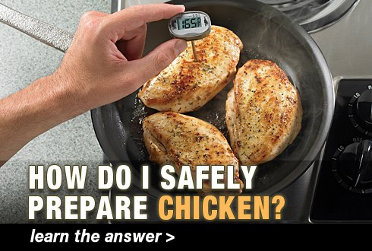
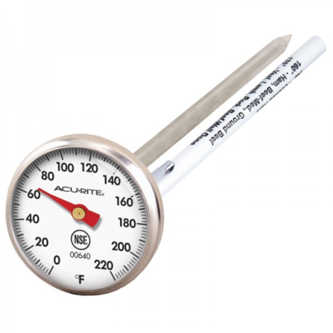
Lesson 3: Temperature Control
Germs can be killed by cooking food to the correct temperature using a food thermometer
GFC requires:
Chicken, Turkey, Duck: 165 °F °F
Ground meat: 155 °F °F
Pork: 145 °F
Fish: 145 °F °F
Steak: 145 °F °F
Re-heating: 165 °F for all Foods
Cooking will not destroy poisons and toxins
Notes:
One of the best way to control germs is to make sure the food is at the proper temperature. Germs can be killed by cooking food to the proper temperature. The Guam Food Code requires poultry products, such as chicken, duck, and turkey, be cooked to 165°F, ground beef, pork, or chicken cooked to 155°F, and regular pork, fish, and steak cooked to 145°F. If food needs to be reheated, they must be reheated to 165°F. To make sure you are reaching the proper cooking temperatures, you must use a food thermometer.
Although cooking can kill germs, they cannot destroy poisons or toxins that some germs make.

Slide 18
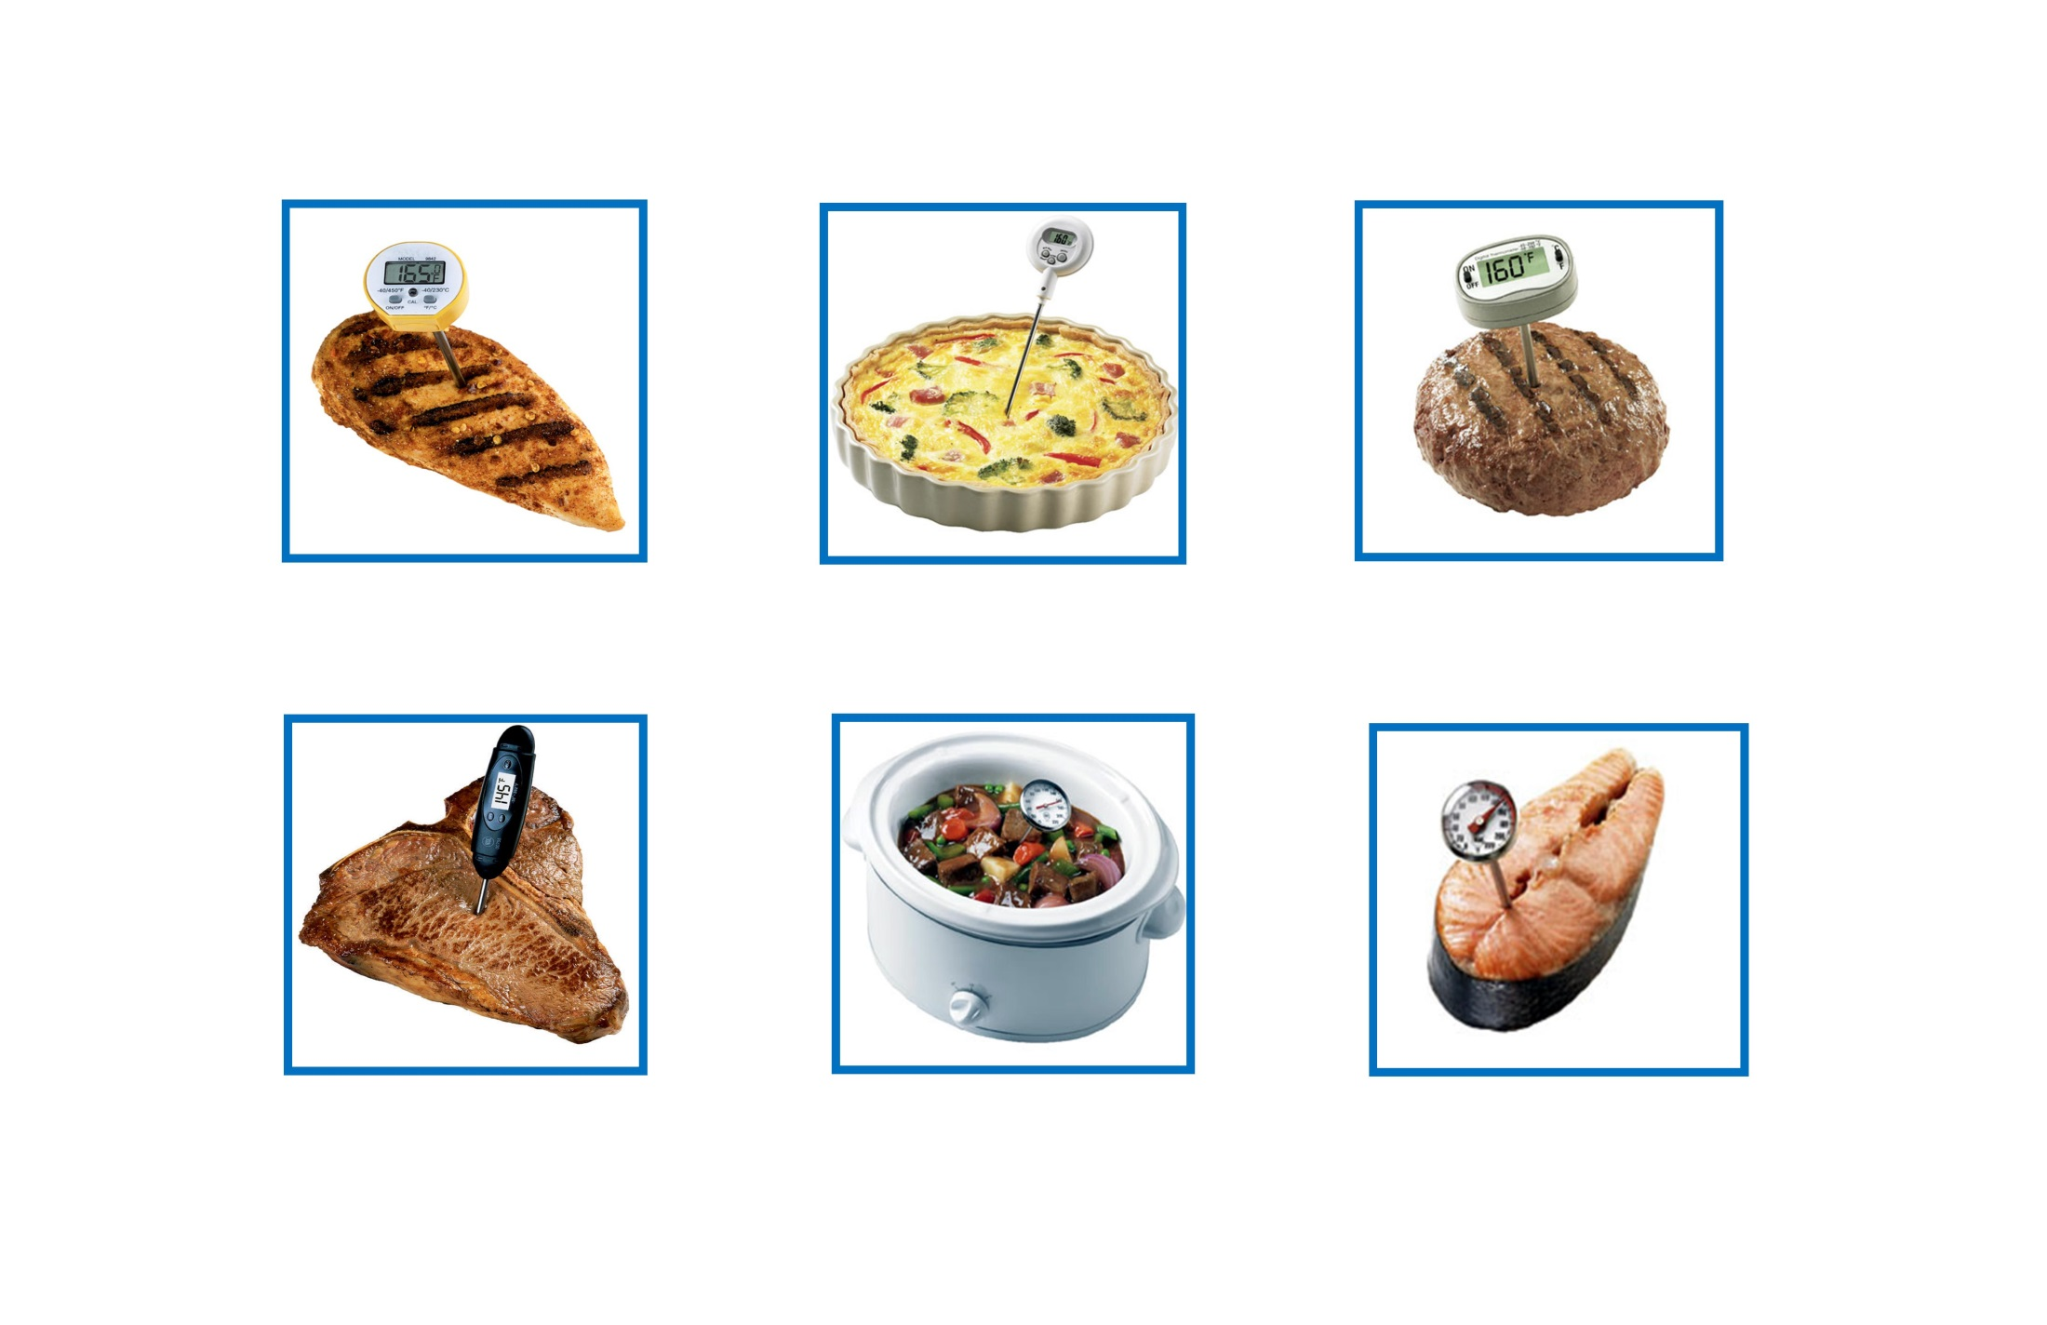
Can you guess the proper cooking temperature?
Chicken = 165°F
Pork Dish = 145°F
Hamburger = 155°F
Steak = 145°F
Beef Stew = 145°F
Fish = 145°F
Notes:
This slide shows examples of different types of food products and the proper cooking temperatures they must be cooked to. All poultry, such as the grilled chicken, must be cooked to at least 165°F. For regular pork, beef, steak, and fish, they must be cooked to at least 145°F. If the food product is a type of ground meat, such as the hamburger, it must be cooked to at least 155°F.

Slide 19
Lesson 3: Temperature Control (cont.)
Chilling and freezing can stop or slow germs from growing (multiplying), but it won’t always kill them
Freezing will not kill all germs, but it will kill most parasites
GFC requires cold foods to be kept at 41 °F or less
GFC requires hot foods to be kept at 140 °F or more
Notes:
Aside from cooking, keeping proper temperatures will help stop or slow the growth of germs. For example, chilling or freezing can help stop or slow germs from growing, but it does not kill them. Although freezing won’t kill all germs, it can kill most parasites.
The whole purpose of controlling temperature is to stop or slow the growth of germs before they can make someone sick.
The Guam Food Code requires cold food to be kept at 41°F or less and hot foods to be kept at 140°F or above. The temperature range between the cold and hot holding temperatures is called the “Temperature danger zone.”

Slide 20
Lesson 3: Temperature Control (cont.)
Temperature Danger Zone
Temperature range that bacteria grows best
TDZ: between 41 °F and 140 °F
Room temperature (No A/C)
About 85 °F = TDZ!
Room temperature With A/C
About 75 °F = Still in TDZ!
Average human body temperature
98.6 °F = TDZ!
Notes:
The Temperature Danger Zone is the temperature range between 41°F and and 140°F. It is at this range that bacteria grow best and if food is left at this temperature, it can make someone sick.
Examples of things in the Temperature Danger Zone of 42°F to139°F are room temperature with no AC, room temperature with AC, and the average human body temperature. In the Temperature Danger Zone, bacteria grow well and grow rapidly. That is why leaving food out at room temperature, even when in AC, is not allowed.

Slide 21
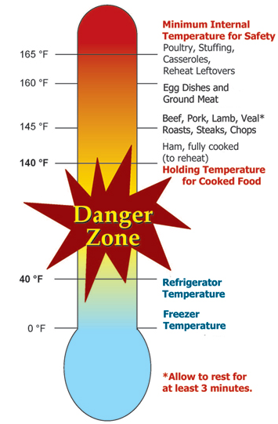
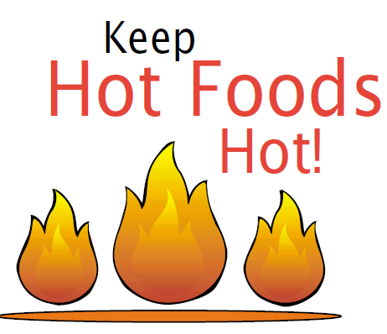
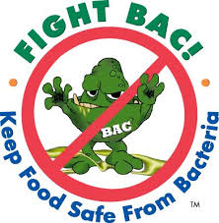
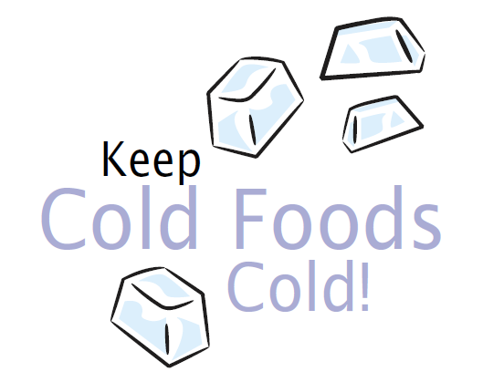
Temperature Danger Zone
Good!
Temperature
BAD!
Temperature Danger Zone
Good!
Temperature
Notes:
Here’s a great picture that identifies the good and bad temperatures. It also provides a great reminder to keep hot foods hot and cold foods cold.

Slide 22
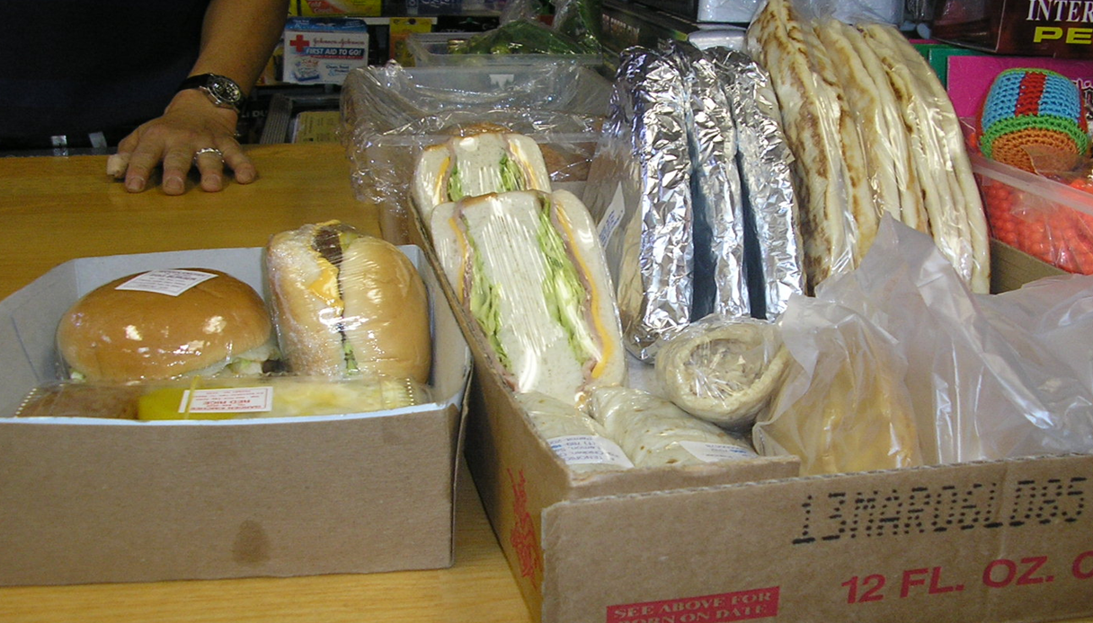
What is wrong with this picture?
Notes:
Here is an example of food being stored at room temperature, which is not allowed.

Slide 23
What is wrong with this picture?
Notes:
The foods identified here in this picture are the types of food that germs love to grow in. Since these food are in the temperature danger zone, or at room temperature, the germs can grow fast. It grows so fast it can make the person who eats it sick from foodborne illness .

Slide 24
Lesson 3: Temperature Control (cont.)
Reheating Food
Food that has been cooked and cooled can be reheated
165 °F for 15 seconds
Thawing Food
Do not thaw food at room temperature, which is the temperature danger zone, because bacteria can grow rapidly when thawing
Acceptable ways to thaw food
In the refrigerator at 41 °F or below
Under cool running water
In the microwave
As part of the cooking process
Notes:
As previously mentioned, food, regardless of the type of food, that was cooked and cooled, must be reheated to at least 165°F for 15 seconds.
If food needs to be thawed, there are only four acceptable ways to thaw food, per the Guam Food Code:
In the refrigerator at 41° F or below
Under cool, running water
In the microwave
Or as part of the cooking process.
Food should never be thawed at room temperature because it allows bacteria to grow rapidly.
Now that we’ve covered proper temperatures, let’s move on to learning about cross contamination and how to prevent it.

Slide 25
Lesson 4: Cross-Contamination
Ready-To-Eat (RTE) – means foods that are ready for consumption without any further cooking.
Cross-contamination is when contaminants from one food is transferred to another food.
Ex: Bacteria on raw chicken transferred to ready-to-eat food.
Cross-contamination is when contaminants from a dirty surface is transferred to food.
Ex: Cutting lettuce for salad on an unwashed cutting board and knife that were used to cut raw chicken.
Notes:
Germs that can cause foodborne illness can be transferred from one surface to another. This is called CROSS-CONTAMINATION. Cross-contamination occurs when a contaminant is moved from one location to another by direct or indirect contact, such as when biological contaminants, like germs, are transferred from raw meat food or dirty hands to clean equipment or food.
Cross-contamination is particularly dangerous for ready-to-eat foods which are types of foods that can eaten since it was already cooked or prepared or doesn’t required any cooking, like fresh fruits and salads. If germs from a dirty surface is transferred to a ready-to-eat food, then the germs on that food will be eaten and may make the person sick with foodborne illness since germs were not killed by cooking.
An example is provided on this slide: A raw chicken was cut on a cutting board and the food-handler used the same cutting board and knife to chop lettuce without washing the cutting board or the knife. So, the bacteria from the raw chicken that contaminated the cutting board and the knife were transferred to the lettuce in a process called cross-contamination. If that lettuce is used for fresh salad, which does not require any cooking to kill germs, and is then eaten, the person may get sick from foodborne disease from eating the germs.

Slide 26
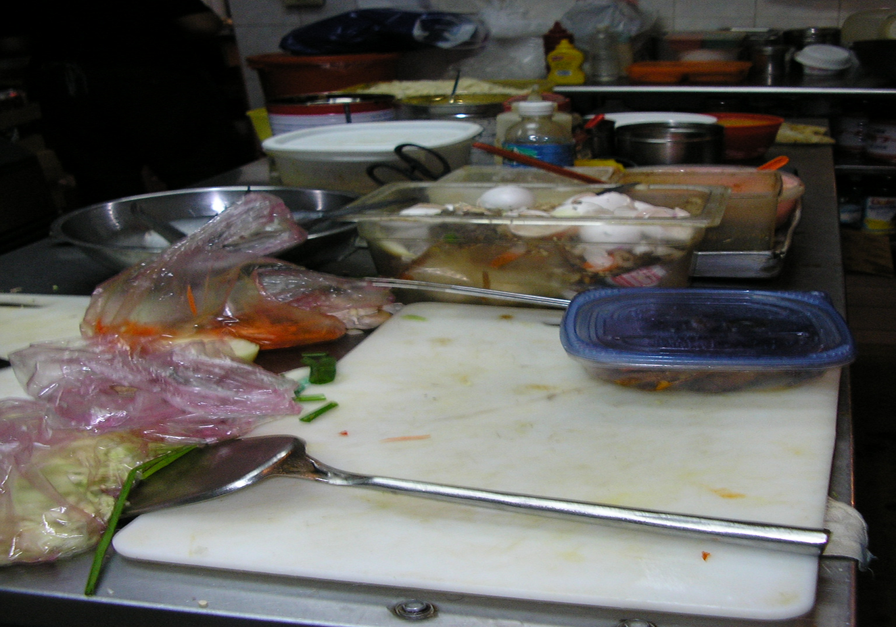
Examples of Cross-Contamination (cont.)
BAD!
Notice the raw and ready-to-eat foods in the picture
The same cutting board was used to prepare both types of food
Notes:
The picture on this slide provides an example of a cutting board being used to prepare both ready-to-eat foods and raw foods, which is dangerous because it may cause foodborne illness.

Slide 27
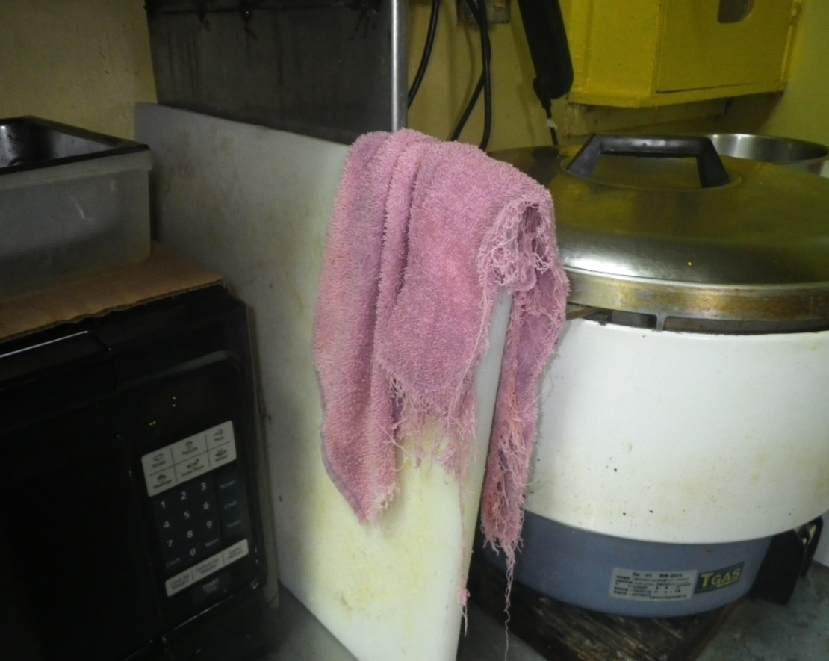
Examples of Cross-Contamination (cont.)
BAD!
Dirty cloth placed on cutting-board
Potential for cross-contamination
Store wiping cloths in sanitizing solution when not in use AND after every use
Notes:
This picture provides another example of cross contamination. A dirty wiping cloth was placed on a clean cutting board.

Slide 28
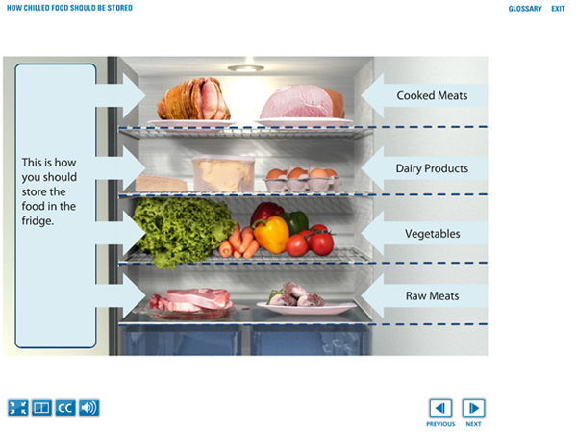

Examples of Cross-Contamination (cont’d)
Contaminants on food can drip or fall onto other foods below, so place those with the greatest potential for contamination at the bottom
Notes:
Food placed inside the refrigerator must be stored in a way that prevents cross-contamination because contaminated food may drip or fall onto other foods that are placed below.
This means food in the refrigerator must be arranged so that the food that is most likely contaminated, like raw meat and raw seafood, is placed at the bottom of the refrigerator while ready-to-eat foods are placed at the top.
Also, raw meat and raw seafood should be arranged by cooking temperatures so that raw food that requires the highest temperature is stored below the product with the lowest temperature for cooking. For example, the cooking temperature for chicken is 165° F, so it must be placed below raw beef, which has a cooking temperature of 145° F.

Slide 29
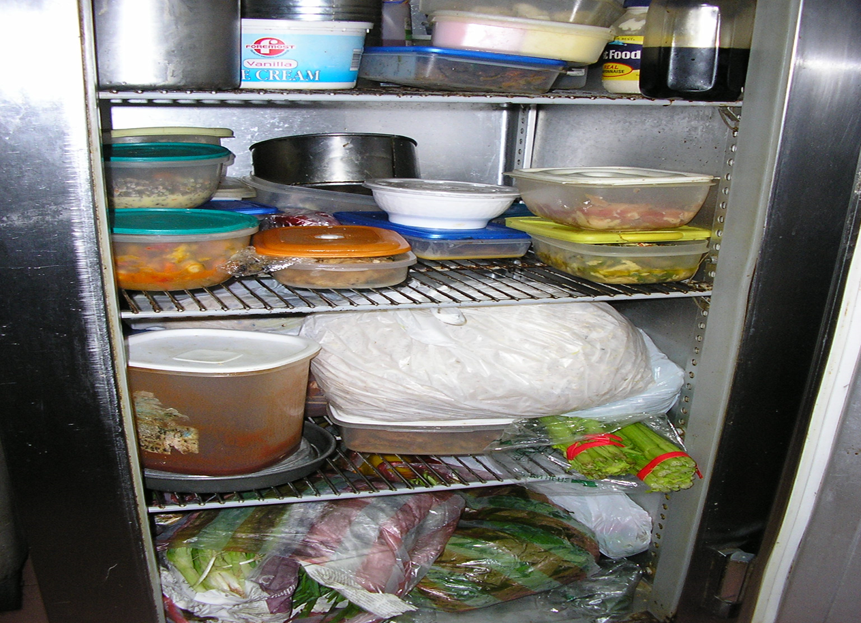
Examples of Cross-Contamination (cont.)
What’s wrong with this picture?
Raw meat
Raw meat
Vegetables
Notes:
This picture provides an example of improper storage inside a refrigerator, which increases the chance for cross-contamination that can lead to foodborne illness. In this picture, different raw meat are stored on top of vegetables; this is wrong and not allowed.

Slide 30
Lesson 4: Cross-Contamination (cont.)
Washing and Rinsing will remove most bacteria and viruses, but not all.
Sanitizing will kill most bacteria and viruses still left after washing and rinsing.
So Wash, Rinse, and Sanitize.
Very hot water can be used as a sanitizer.
Notes:
To help prevent cross-contamination, utensils and equipment must be washed and rinsed, which helps remove most bacteria and viruses, then sanitized, which will kill most bacteria and viruses that may be still be on the surface after washing and rinsing.
You can use chemical sanitizers, or very hot water, to sanitize. Let’s discuss the steps you must follow to wash, rinse, and sanitize.

Slide 31
Lesson 4: Cross-Contamination (cont.)
Properly wash contaminated utensils, plates, and other food-contact surfaces by:
Scrape off as food much as possible into garbage container,
Wash with approved detergent,
Rinse with clean, hot water,
Sanitize with approved chemical or hot water, and then
Air Dry
Wash, Rinse, and Sanitize using Three-Compartment Sink or Automatic Dishwasher
Notes:
The steps properly wash, rinse, and sanitize utensils, plates, and other items are discussed on this slide. The first step is to scrape or remove as much food as possible into a garbage container.
Then, you must wash using an approved detergent in the correct water temperature, and then rinse off the detergent with hot water. Afterwards, the items must be sanitized with the correct sanitizer or hot water, and finally it must be air dried. Do not wipe-off the utensil, plate, and other sanitized items that have been air dried; you must let it air-dry.
These steps must be done using a three-compartment sink or automatic dishwasher.

Slide 32
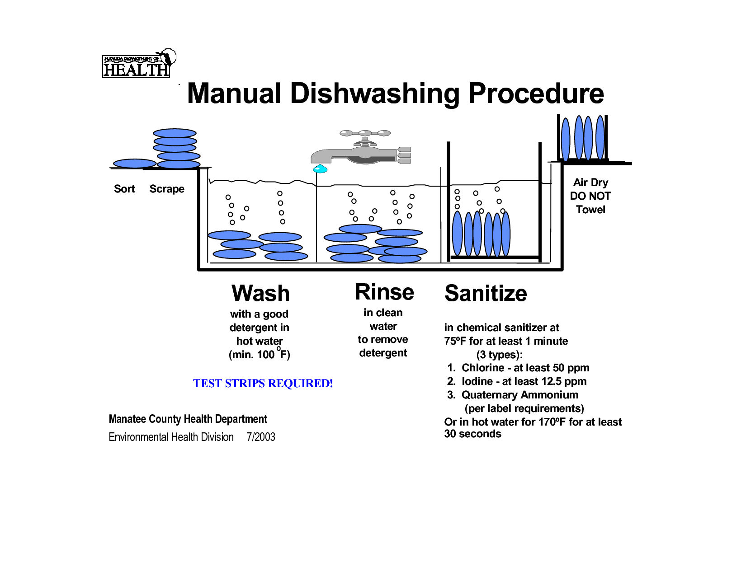
Using a 3-Compartment Sink for Ware-washing
Air Dry
STEP 1
STEP 2
STEP 3
STEP 4
STEP 5
Notes:
A three-compartment sink is shown on this slide with the proper steps of scraping, washing, rinsing, sanitizing, and air drying.

Slide 33
Lesson 4: Cross-Contamination (cont.)
Cleaning and sanitizing are not the same thing.
Cleaning is done by using soap and water to remove food, grease, and dirt.
Sanitizing is done by using chemicals or heat to kill germs.
There are different types of sanitizers, chlorine is the most common.
No matter how you wash items, you will need to use chemical test strips to ensure that you are using the right amount of chemical sanitizer to kill germs.
Notes:
One thing to keep in mind is that cleaning and sanitizing are the not the same thing. Cleaning requires soap and water to remove food, grease, and dirt from the surface. For sanitizing, you need to use approved chemical or heat to kill the germs. But you have to clean first before sanitizing for it to be effective.
There are different types of sanitizers you can use, and chlorine is the most common. If you are using a chemical sanitizer, you must use a chemical test strip to ensure that the sanitizer you are using is properly mixed in the right amount to kill germs. The chemical test strip will allow you to tell whether your sanitizer is too weak, too strong, or just right.

Slide 34
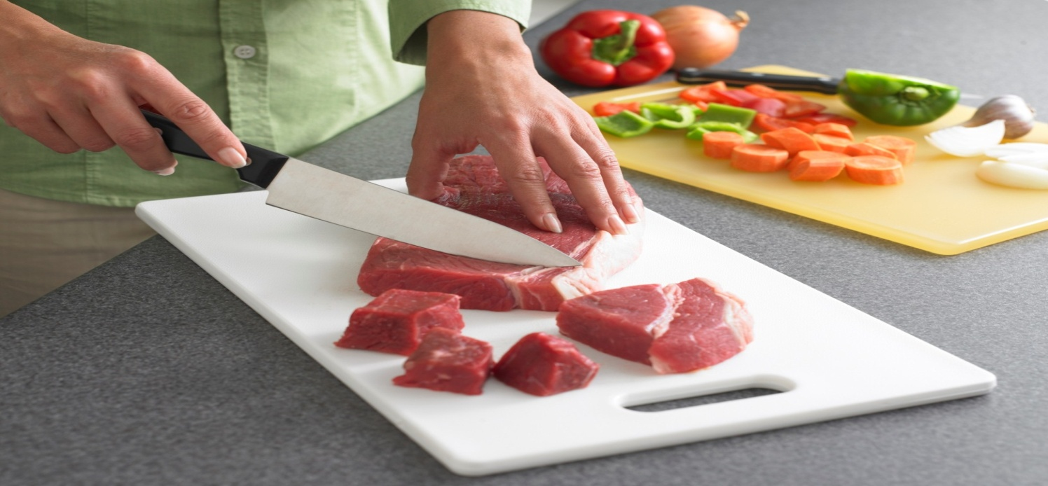
Lesson 4: Cross-Contamination (cont.)
Prevent Cross-Contamination when using a cutting board
Wash, rinse, and sanitize the cutting-board and knife after cutting raw meats, fish, and poultry; or
Use a separate knife and separate cutting-board for cutting raw products (meat, poultry, fish, pork) and cutting ready-to-eat foods (vegetables).
Notes:
It is important to remember that cutting boards and knives must be washed, rinsed, and sanitized after being used to cut raw meats, raw fish and raw poultry to prevent cross-contamination. If that can’t be done, then use a separate cutting board and knife for ready-to-eat foods.

Slide 35
Lesson 4: Cross-Contamination (cont.)
Food-handlers need to prevent cross-contamination so the food they serve, or sell do not have germs or other contaminants that can sicken consumers.
GFC has requirements food-handlers must follow to prevent cross-contamination.
Notes:
Food-handlers need to make sure cross-contamination is prevented so the food that you serve, or sell, is safe to eat. This includes protecting the food from yourselves by following the Guam Food Code requirements for proper employee health and hygiene, which will be discussed next.

Slide 36
Lesson 5: Employee Health and Hygiene
A healthy food-handler is one of the most important factors in preventing foodborne illness.
When you feel sick, you should not work with food.
The germs that are making you sick may contaminate the food you are handling, which may cause those that eat the food to get sick as well.
Sick workers should either be sent home or given duties that do not involve handling food or food-contact surfaces.
Notes:
Food-handlers, such as yourself, must take the proper steps to prevent the contamination of food. If you are feeling sick, then you must not be working with food or surfaces that contact food.
The germs making you sick may contaminate the food you are handling and cause others to get sick as well. Sick workers must be sent home or given duties that do not involve food or food-contact surfaces. In this lesson, we will go over employee health and hygiene.

Slide 37
Lesson 5: Employee Health and Hygiene (cont.)
When not to work or handle food:
When you have diarrhea!
You may be releasing germs or parasites.
When you have a stomachache!
You may be infected with foodborne illness.
When you have sore throat with a fever!
Your cough may have germs.
Notes:
If you are experiencing diarrhea, stomachache, or sore throat with fever, you should not be working or handling food. Diarrhea and stomachaches are symptoms associated with foodborne illness. You may be releasing germs or parasites onto the food you are handling.
If you have a sore throat with fever, your cough may have germs that can get onto the food you are handling.

Slide 38
Lesson 5: Employee Health and Hygiene (cont.)
When not to work or handle food:
You are vomiting.
Your vomit may have germs.
Your skin or eyes are yellow.
You may have Hepatitis A.
You have infected and uncovered wounds.
Puss or scabs may get into the food.
Notes:
You must not work or handle food if you are also vomiting, have yellow skin or eyes, or have an infected and uncovered wound, especially if it’s on your hands and arms.
The yellowing of the skin or eyes is called jaundice and is a sign of a more serious disease, called Hepatitis A. If you have these symptoms, you should not be handling food or touching food-contact surfaces.

Slide 39
Lesson 5: Employee Health and Hygiene (cont.)
If you are sick, you may contaminate the food that you serve to your customers.
You may get germs on your hands after using the restroom, vomiting, or coughing.
Germs in your vomit or cough may become airborne and land on food or food-contact surfaces.
Notes:
If you are sick, you can contaminate the food when the germs get on your hands after using the restroom, vomiting, or coughing. The germs in your vomit or cough may become airborne and land on the food or food-contact surfaces.
Even when you are not sick, you should still practice good personal hygiene, which the Guam Food Code provides.

Slide 40
Lesson 5: Employee Health and Hygiene (cont.)
WHEN WORKING:
DO NOT eat food!
But you can drink but from a closed container with a straw
DO NOT chew gum, tobacco, or betel nut!
DO NOT spit!
DO NOT wear jewelry!
Notes:
The Guam Food Code provides requirements for good personal hygiene.
This includes not eating when working. Drinking is permitted, but only if you are drinking from a closed container with a straw and steps are taken to prevent cross-contamination.
You cannot chew gum or betelnut, or use tobacco, in the working area. You cannot wear jewelry, except a simple wedding band, when working.

Slide 41
Lesson 5: Employee Health and Hygiene (cont.)
Bathe before work.
Notes:
We can also practice good personal hygiene by making sure you bathe before coming to work.

Slide 42

Lesson 5: Employee Health and Hygiene (cont.)
Not work when sick.
Notes:
You should not be working while you are sick.

Slide 43
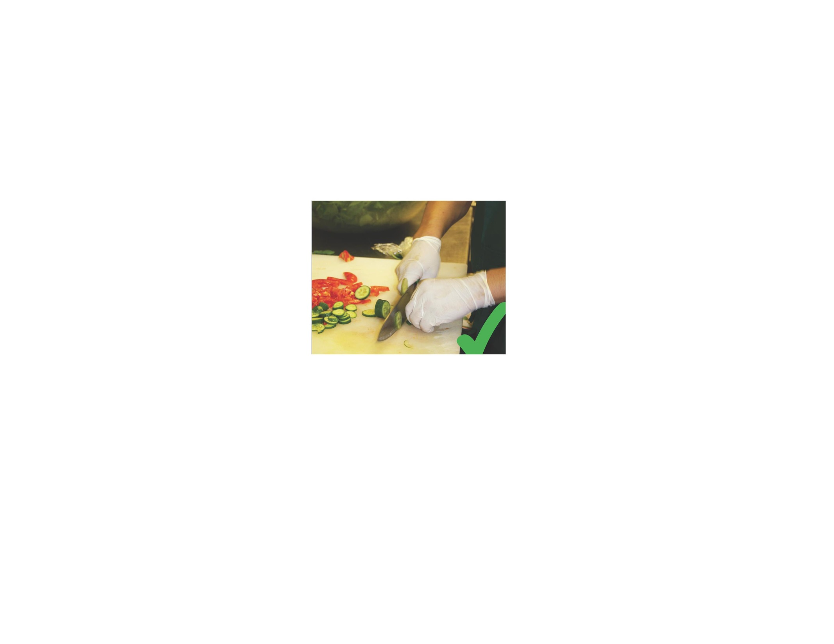
Lesson 5: Employee Health and Hygiene (cont.)
Wear gloves when touching ready-to-eat foods.
Notes:
Wearing gloves when touching ready-to-eat food, such as the one shown on this picture, promotes good employee health and hygiene.

Slide 44

Lesson 5: Employee Health and Hygiene (cont.)
No smoking, vaping, eating, chewing, or spitting when working.
Notes:
It is important to remember that as a food-handler you cannot smoke, vape, eat, chew, or spit while working.

Slide 45
Lesson 5: Employee Health and Hygiene (cont.)
Keep fingernails short!
Keep your clothes clean!
Keep your hair restrained!
Cover open cuts and wounds!
Always wash your hands!
Fastest, easiest, and cheapest way to prevent foodborne illness
Notes:
Good personal hygiene also includes keeping your fingernails short and clean, keeping your clothes clean; making sure your hair is properly restrained with a hairnet or cap; covering any open cuts or wounds; and most importantly, always washing your hands.
In fact, the most important thing you can do to keep germs off of your hands is to properly wash your hands. Proper handwashing is the fastest, easiest, and cheapest way to prevent foodborne illness. Let’s discuss this further.

Slide 46
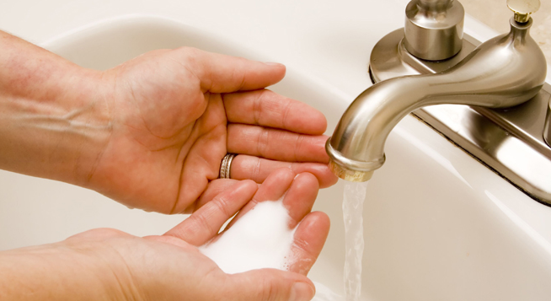
Lesson 5: Employee Health and Hygiene (cont.)
When to wash your hands at work.
Notes:
Proper handwashing also includes knowing when to wash your hands at work.

Slide 47

Lesson 5: Employee Health and Hygiene (cont.)
When to wash your hands?
After using
the Toilet
Notes:
Hands must be properly washed after using the toilet

Slide 48
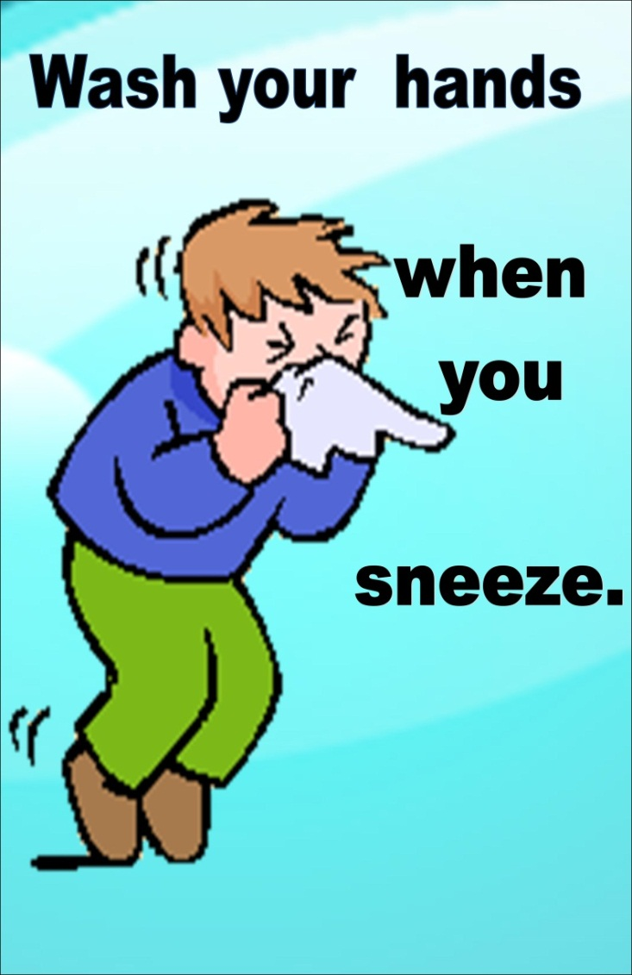
Lesson 5: Employee Health and Hygiene (cont.)
When to wash your hands?
Notes:
After coughing, sneezing, using a handkerchief or disposable tissue.

Slide 49
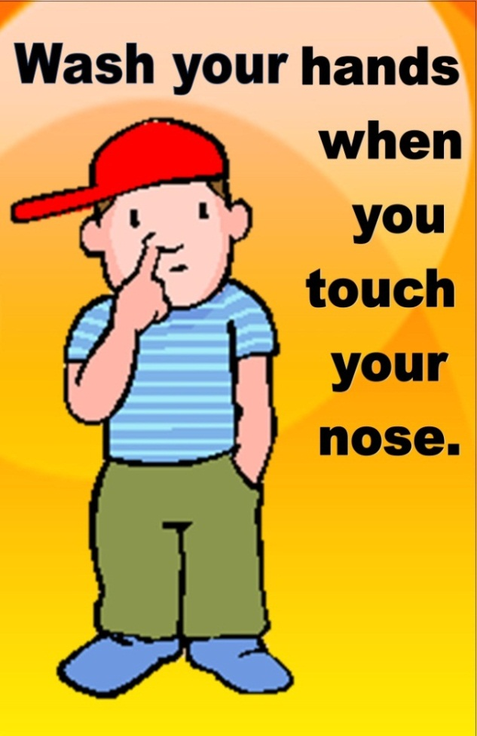
Lesson 5: Employee Health and Hygiene (cont.)
When to your wash hands?
Notes:
After touching your eyes, nose, and mouth or any bare human body parts.

Slide 50

Lesson 5: Employee Health and Hygiene (cont.)
When to wash your hands?
Before putting on new gloves.
Notes:
Right before putting on new gloves.

Slide 51
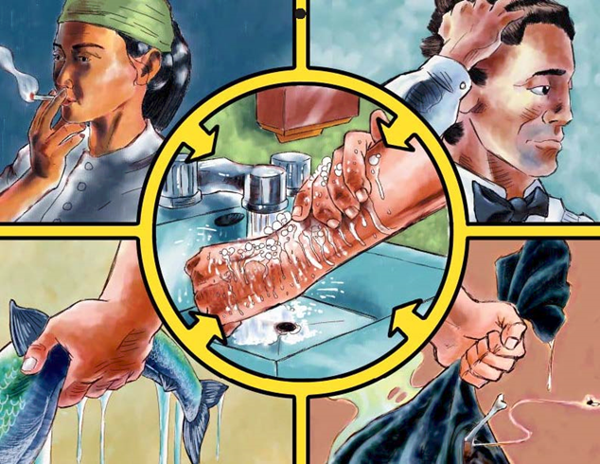
Lesson 5: Employee Health and Hygiene (cont.)
Notes:
After smoking, eating, drinking, touching dirty equipment or utensils, or after touching raw food. Hands must be washed any time you are engaging in an activity that contaminate your hands.
Next let’s discuss how you properly wash your hands.

Slide 52
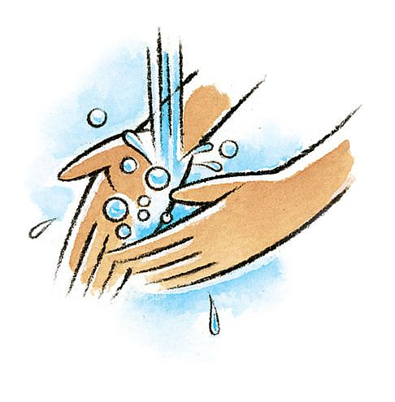
Lesson 5: Employee Health and Hygiene (cont.)
How to wash hands?
Turn on faucet using warm water
Wet hands and put soap
Lather and vigorously rub hands
Between fingers, around fingernails, thumbs
Rinse hands while still rubbing under running water
Grab paper towel and dry, and use it to turn off faucet and open door
Air dryer okay, but paper towel more hygienic
Notes:
Handwashing is so important that the Guam Food Code gives instruction in how to do it.
Food employees must keep their hands and exposed pats of their arms clean. Employees must clean their hands and exposed parts of their arms for at least 20 seconds with warm water and soap. The following steps must be followed by food-handlers so to properly wash their hands:
Turn on the faucet so the water is warm.
Wet your hands and apply an amount of soap recommended on the label.
Rub your hands together vigorously for at least 10-15 seconds while paying close attention areas between your fingers, around fingernails, and your thumb.
Thoroughly rinse your hands under warm, running water.
And using a paper towel, thoroughly dry your hands and use the same paper towel to turn off the faucet and open the door.
You can use a hot air dryer, but a paper towel is more hygienic because you can use that to turn off the faucet and open the door without contaminating your hands.
Following proper handwashing is very important because it helps keep your hands clean especially when you are handling or working with food.

Slide 53
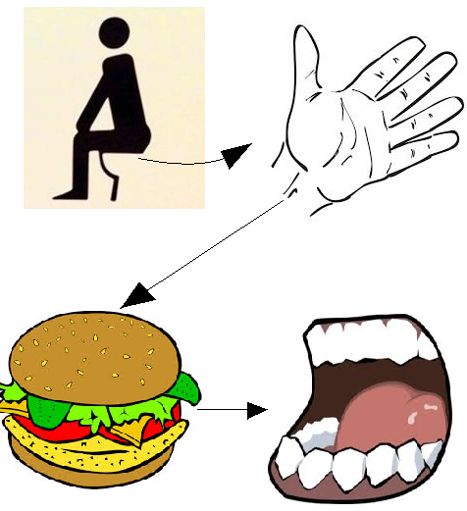
Lesson 5: Employee Health and Hygiene (cont.)
When you don’t wash your hands after using the toilet:
Germs in feces (poop) can get on your hands.
If you don’t properly wash your hands, the poop can get on the food you handle.
Your customer then eats the food with your poop which contains germs!
Customer may get sick.
Notes:
As this slide shows, if you don’t wash your hands, especially after using the toilet, germs in your feces, which is another name for poo-poo, can get onto your hands and transfer onto the food you handle. When your customers eat the food, they may get sick.

Slide 54



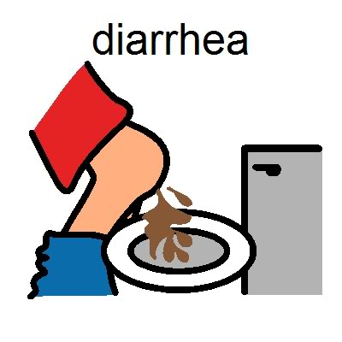

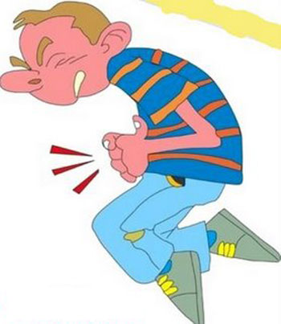

Comes in to work
Does not wash hands
comes to work
Serves to Customer
Sick Worker Contaminates Food
Serves to Customer
and gets foodborne
illness with symptoms:
Customer gets sick with the following symptoms:
Diarrhea
Vomiting
Abdominal Cramps
Diarrhea
Vomiting
Abdominal Cramps
Jaundice
Notes:
Here we have another slide showing what can happen if a sick employee comes into work. The sick food-handler with jaundice, as this example shows, contaminates the food which is then served to a customer. The customer then gets sick and experiences jaundice, abdominal cramps, vomiting, and diarrhea.
To prevent this from happening, all food handlers should follow the procedures we’ve discussed, which is not working while sick and practicing good handwashing and other hygienic practices.

Slide 55
Lesson 5: Employee Health and Hygiene (cont.)
Wearing Gloves
When handling ready-to-eat (RTE) foods.
RTE foods are ready to be served and no further cooking is required
If the food requires further cooking it is not RTE food.
Examples: Salads, Desserts, Sushi
If you do not have access to gloves, then the use of tongs, deli tissue, or other approved material
Do not touch RTE foods with your bare hands!
Notes:
Wearing gloves when handling ready-to-eat food is another example of good hygienic practices. Like we discussed earlier, ready-to-eat foods are foods that do not require further cooking or processing. Because of this, it’s important to prevent contamination of ready-to-eat foods.
The Guam Food Code does not allow the use of bare-hands when handling ready-to-eat foods. This means, gloves, tongs, deli tissues, or any other approved material must be used to handle ready-to-eat food.
If you are using gloves, you have to know how and when to use them correctly.

Slide 56
Lesson 5: Employee Health and Hygiene (cont.)
Proper use of single-use, food-grade gloves
Wash your hands before putting on gloves
Change gloves whenever you change tasks
Change gloves after you touch raw meat, poultry, fish, and eggs
Change gloves every 4 hours
Change gloves whenever it tears or has holes
Only use clean gloves
Do not re-use gloves
Gloves can become contaminated, just like your hands
Frequently change gloves when wet from sweat
Notes:
Gloves are considered single-use. This means that you cannot use the same gloves for different tasks and use them over and over again.
Hands have to be properly washed before putting on gloves and it needs to be changed when you change tasks. This means if you are using gloves to touch raw meat, poultry, fish, and eggs, you need to change your gloves when you do something else. If you don’t change tasks, gloves must still be changed every 4 hours. If gloves have holes or tears or are wet from sweat, change them even if it’s been less than 4 hours. Always use clean gloves and again, do not reuse gloves.
Disposable gloves in a food establishment is not used to protect your hands. Gloves used in a food establishment are used to protect the food from your hands. You must use the gloves properly to prevent contamination of food from a food-handler’s hands.

Slide 57
Lesson 6: Approved Source
What is an “Approved Source”?
Food establishment that has a Sanitary Permit from DPHSS
Distributors, importers, and wholesalers with a Sanitary Permit is an approved source
Make sure your food ingredients and other food items that you get from other local businesses are from an “approved source”
Food made at your private home is NOT an approved source
Notes:
The last risk factor the Guam Food Code identifies that causes foodborne illness is foods from an unapproved source. Unapproved source means the food establishment where the food came from does not have a Sanitary Permit from the Department of Public Health and Social Services. This means they have not been inspected by the Department to make sure they have met the minimum requirements to operate a food establishment. Food made at your private home is not considered an approved source, as well as any establishment that does not have a valid Sanitary Permit.
Distributors, importers, and wholesalers with a valid Sanitary Permit are considered an approved source. Make sure the food you are serving and the food ingredients you are using are all from an approved source.

Slide 58
Lesson 7: Potentially Hazardous Food (PHF)
PHF are:
Food requiring temperature to control germs
Raw animal food
Sprouts
Cut melons
PHF have been associated with food-borne illnesses
Guam Food Code requires proper handling, storage, cooking, and preparation of PHF
Notes:
Next, let’s discuss what are “potentially hazardous food” and how do they play a role in all the requirements we’ve discussed so far.
PHF, or potentially hazardous food, are foods that require the correct control of time and temperature to keep them safe for eating. These foods are usually moist, has protein, and are neutral or slightly acidic. These types of food have been associated with foodborne illnesses and require proper handling, storage, cooking, and preparation.

Slide 59
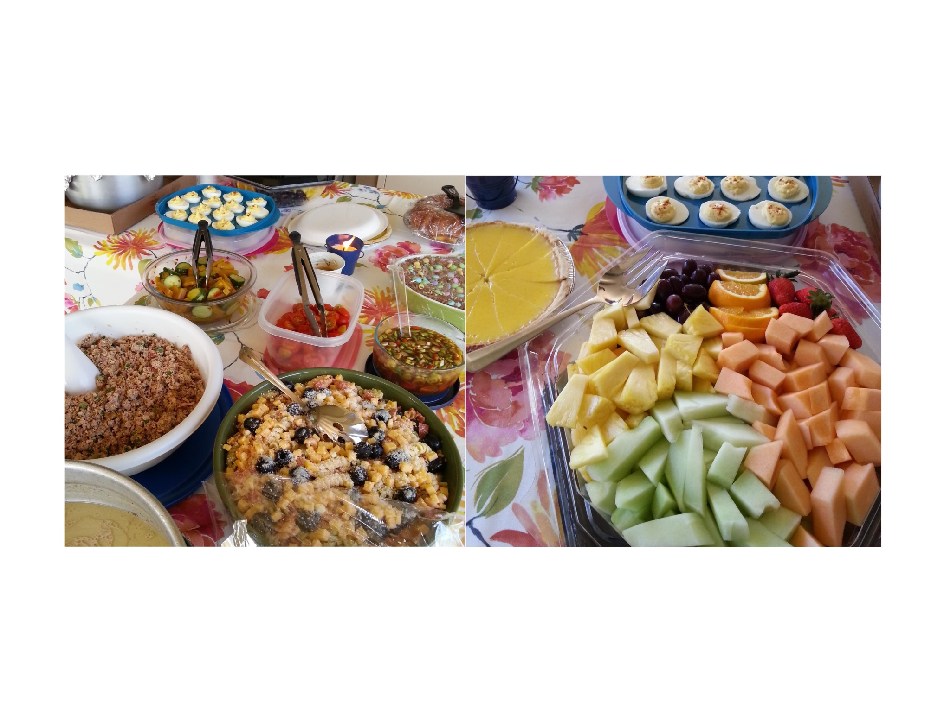
Lesson 7: Potentially Hazardous Food (PHF)
Can you find the PHF in this picture?
Notes:
Next, let’s discuss what are potentially hazardous food and how do they play a role in all the requirements we’ve discussed so far.

Slide 60
Lesson 7: Potentially Hazardous Food (PHF)
Can you find the PHF in this picture?
Notes:
Potentially hazardous foods are foods requiring time and temperature control to keep them safe.
As mentioned earlier, these foods are usually moist, has protein, and are neutral or slightly acidic.
In the table setting shown on this slide, all the potentially hazardous food are circled: kelaguen, macaroni salad, custard pie, deviled eggs, and cut melons. These types of food will allow germs to grow if proper temperature control was not followed.

Slide 61
Lesson 8: Date Marking
Date marking is required by the Guam Food Code to ensure RTE foods that are PHF are not kept for more than 7 days in the refrigerator
PHF RTE food should be marked with the date it was prepared or the date it needs to be thrown away
Date marking prevents germs from growing to levels that can cause foodborne illness
Example: If potato salad was prepared on April 1, it must be sold or thrown out by April 7
Notes:
Understanding what are Potentially Hazardous Food can also help you understand date marking requirements. Date marking is required for all Potentially Hazardous Food and ready-to-eat foods kept in the refrigerator and should be thrown away after 7 days. These foods must be marked with either the date they were prepared or the date they need to be discarded. So for example, if a Potentially Hazardous Food or ready-to-eat food, such as potato salad was prepared on April 1st, the date marked must either be April 1, which is the preparation date, or April 7, which is the date the food must be thrown away.
Date marking is important because there are some bacteria that can still grow very slowly in refrigerated temperatures. Potentially Hazardous Food and ready-to-eat food kept in the refrigerator must be monitored using date marking so you know when they must be thrown away.

Slide 62
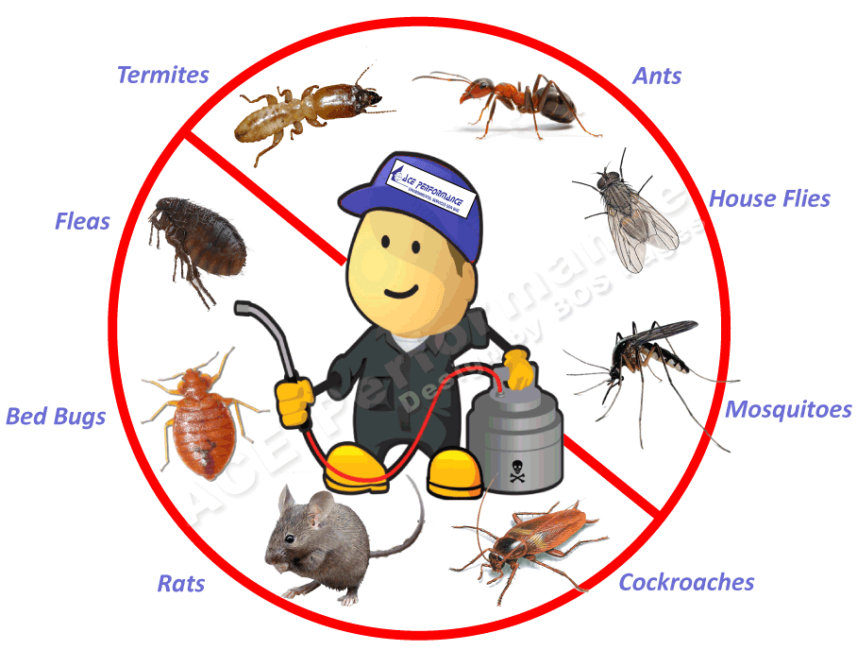
Lesson 9: Pest Control
What are Pests?
Pests are animals or insects that can
contaminate food and make people sick or
bite or sting workers and customers
Examples?
Rodents: rats and mice
Insects: flies, cockroaches, beetles, ants, wasps, bees, and various insects that can be found in stored products
Birds: pigeons
Guam Food Code prohibits animals in establishments, except service animals
Notes:
Another important topic we will be discussing is pest control.
Pests are animals or insects that can contaminate food make people sick. These pests can also bite or sting workers and customers and not allowed in a food establishment.
Pests include rodents, such as rats and mice; insects, such as flies, cockroaches, beetles, ants, wasps, bees, and other insects; and birds, such as pigeons.
The Guam Food Code does not allow pests and animals inside food establishments except for service animals, like dogs for the blind.

Slide 63
Lesson 9: Pest Control (cont.)
How to prevent and control pests:
Pest-proofing the establishment and surroundings
Install insect screens
Good sanitation
Hire professional pest control service
Inspecting food premises regularly
Notes:
To prevent and control pests, establishments must make it difficult for pests to enter the food establishment and its surroundings. This includes installing insect screens and covering up openings where pests may enter.
Practicing good sanitation will also help prevent and control pests since they need food and water to survive. If there are pests present at your establishment, you must hire a professional pest control service; you are not allowed to spray pesticides that you buy at a regular store.

Slide 64
SUMMARY
You must have a valid Health Certificate to work
Most foodborne illnesses are caused by germs (biological contaminant)
Germs grow well in potentially hazardous foods so these foods require proper handling, storage, cooking, and preparation because they can cause foodborne illness
Using proper hot and cold temperatures for cooking and storing food is important to prevent germs from causing foodborne illness
Food-handlers must prevent cross-contamination of food
Food-handlers must be clean and practice clean behavior
Only use food from “approved sources”
Date marking is required for PHF & RTE foods; must be sold or discarded within 7 days
Pest control is important to prevent animals and insects from contaminating foods
Notes:
So we are now at the end of this presentation, but let’s go back and quickly go over the most important things we just learned about food safety and preventing foodborne illness:
You must have a valid Health Certificate to work.
Most foodborne illnesses are caused by germs (biological contaminant).
Germs grow well in potentially hazardous foods so these foods require proper handling, storage, cooking, and preparation because they can cause foodborne illness
Using proper hot and cold temperatures for cooking and storing food are important to prevent germs from causing foodborne illness.
Food-handlers must prevent cross-contamination of food.
Food-handlers must be clean and practice clean behavior.
Only use food from “approved sources.”
Date marking is required for potentially hazardous foods and ready-to-eat foods, and they must be either sold or thrown away within 7 days.
Pest control is important to prevent animals and insects from contaminating foods.

Slide 65
Assessment and Evaluation
Any Questions Before The Test?
Notes:
Survey participants to see if they found the training beneficial.

Slide 66
Health Certificate Interim Test

Slide 67
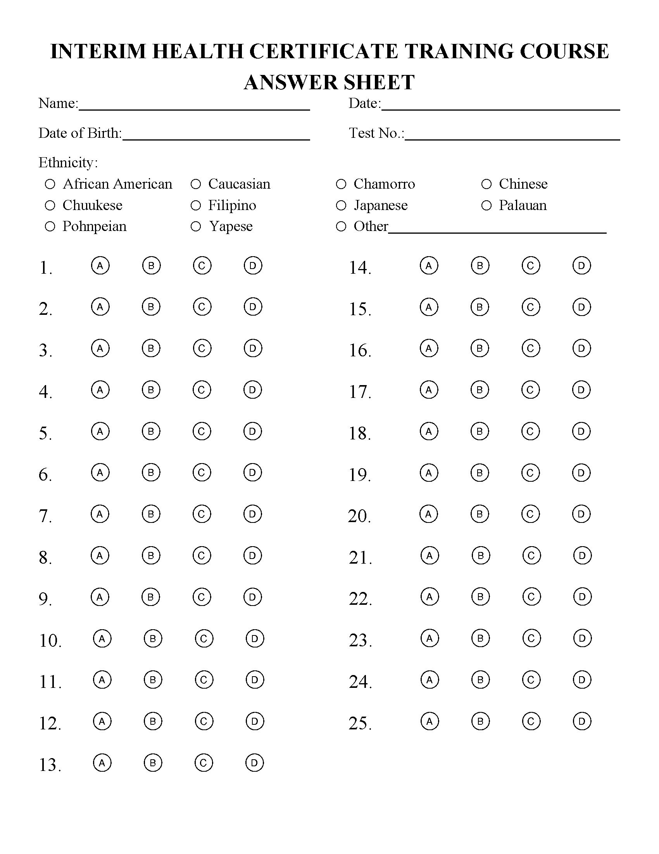

Test Directions
TEST NUMBER
WRITE THE TEST NUMBER IN THE TEST NO SPACE.
DO NOT WRITE IN THE TEST
READ EACH QUESTION CAREFULLY AND CHOOSE ONLY ONE ANSWER AND FILL IN THE CIRCLE.
GRADED, 70% OR HIGHER TO PASS. 70% = 7 MISTAKES.
CELLPHONES AND MANUALS MUST BE PUT AWAY.
DO NOT LOOK AT YOUR NEIGHBORS ANSWER SHEET.

Slide 68

Thank You!
DIVISION OF ENVIRONMENTAL HEALTH
Department of Public Health and Social Services
TEL: (671) 922-2533
FAX: (671) 922-2534
EMAIL: dphss-deh@dphss.guam.gov
www.dphss.guam.gov
Notes:
Thank you for attending the Food Safety Health Certificate Food Safety Training Course for those holding an Interim Health Certificate. For any questions or concerns, you can contact us at the phone number provided and/or email us.
To get the latest news and updates from our Division of Environmental Health, you can find us on Facebook, Instagram, and Twitter.

